Slide 1


AUTOMATED WISHING SYSTEM
AOOP PROJECT
Under the guidance of
Dr. Anuradha Nandula

Slide 2


TEAM MEMBERS
2110030019 –I N Chiranjeevi
2110030041 – K Shikha
2110030100 – E Srivardhan Reddy
2110030110 – J Laasya Kruthi

Slide 3
Problem Statement
With a classic automation, you can make sure each contact gets a custom birthday message on the right day for them. Sending Birthday SMS Automatically is a Great help for All those people who want to save time and make customers and employees Happy To Get SMS on Birthday makes you feel so special.

Slide 4
Abstract
This project is about an automated birthday wishing system which is programmed by using JAVA
The main aim of this application is to design a program which wishes people on their birthdays through a message which can be sent through few social media applications like DISCORD, TELEGRAM, EMAIL
Basically, this is done by using bot API for the specific social media platforms like
JDA (java discord API) for discord
Java telegram bot API for telegram
“Java mail API” and “SMTP” (simple mail transfer protocol) for email

Slide 5
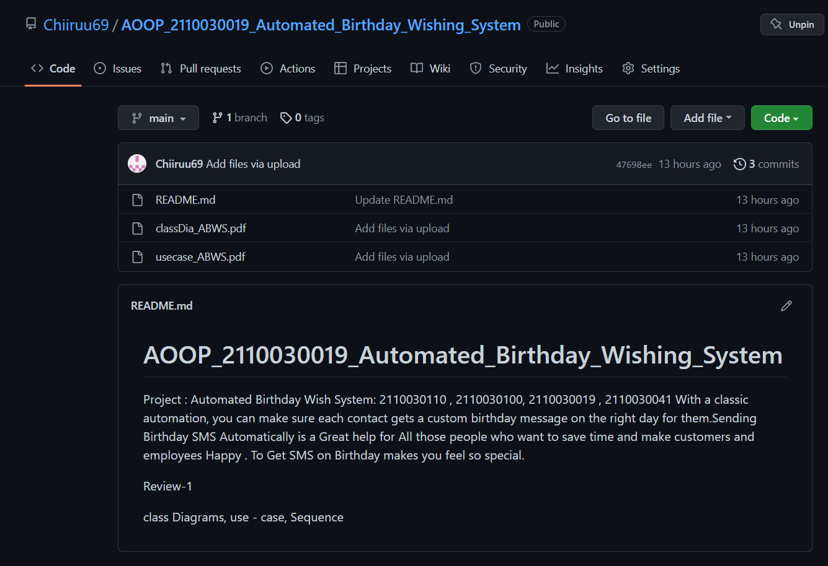
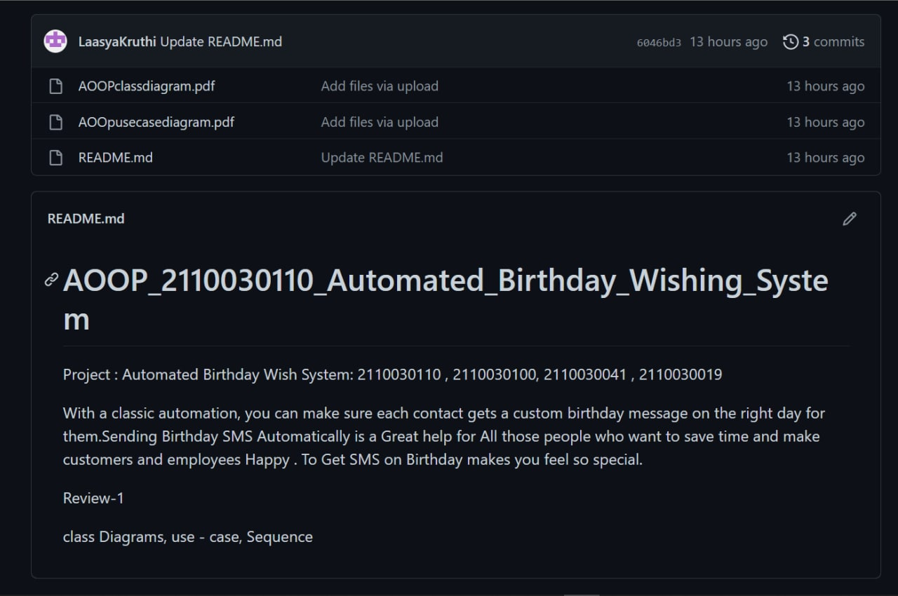
GitHub profiles

Slide 6
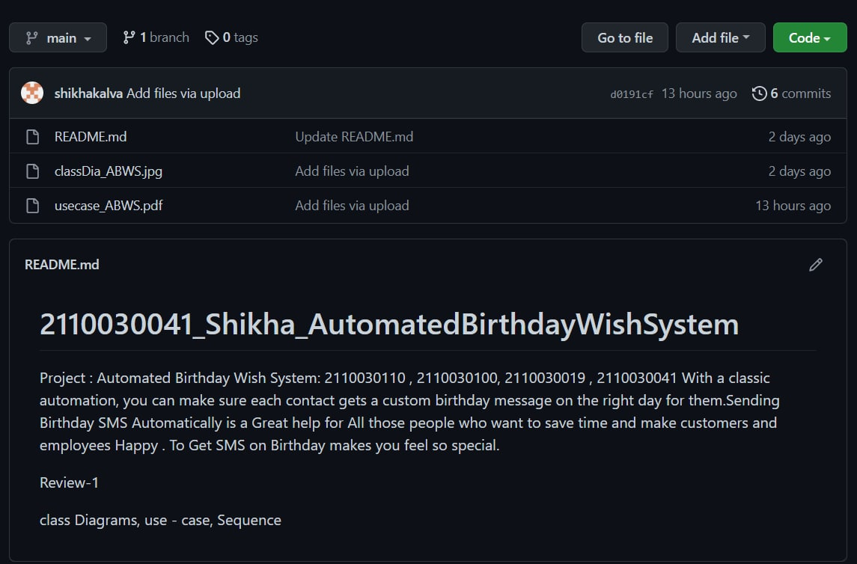
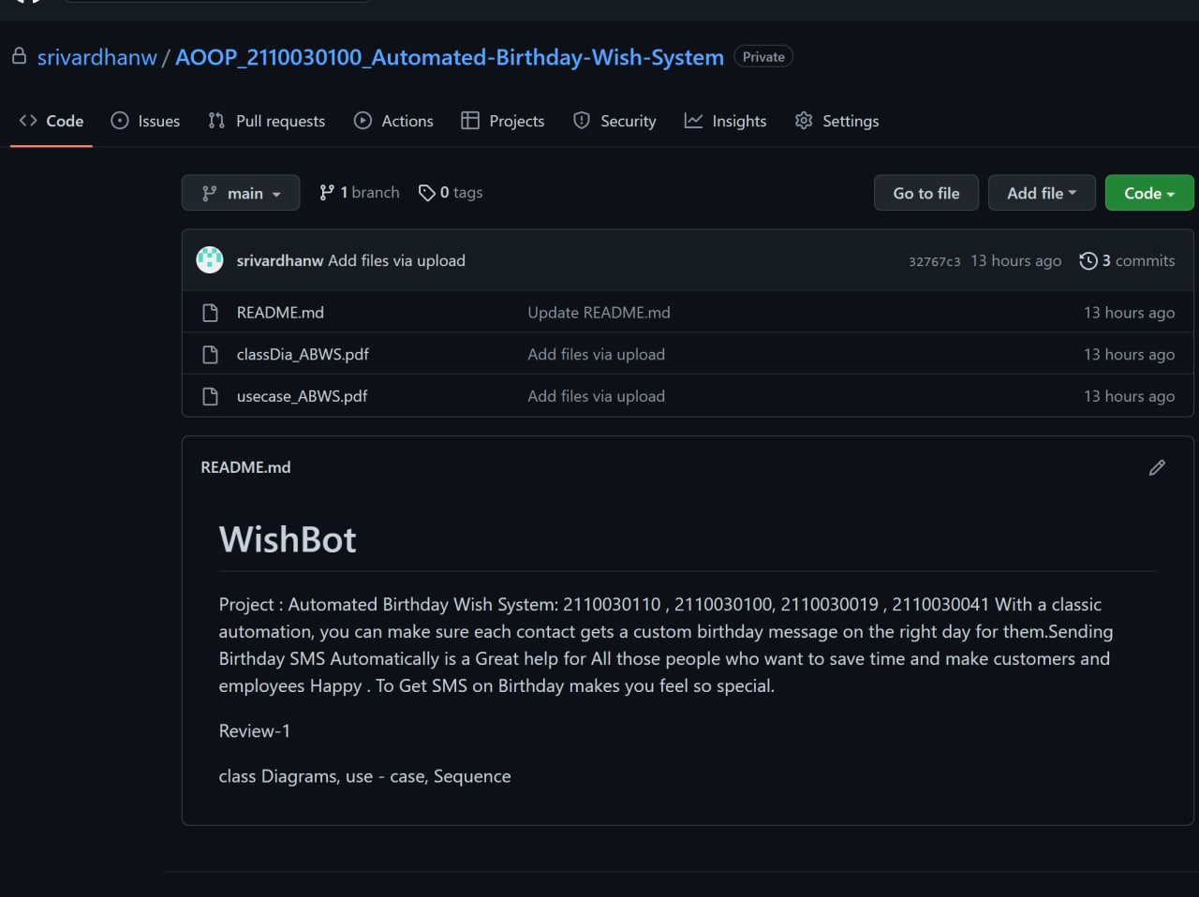

Slide 7
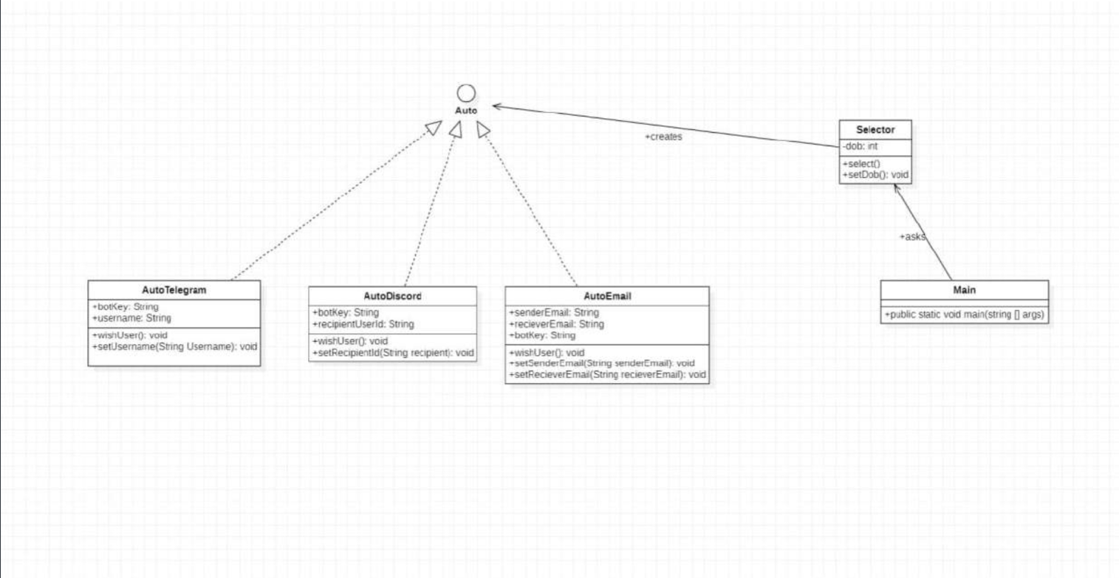
Class diagram

Slide 8
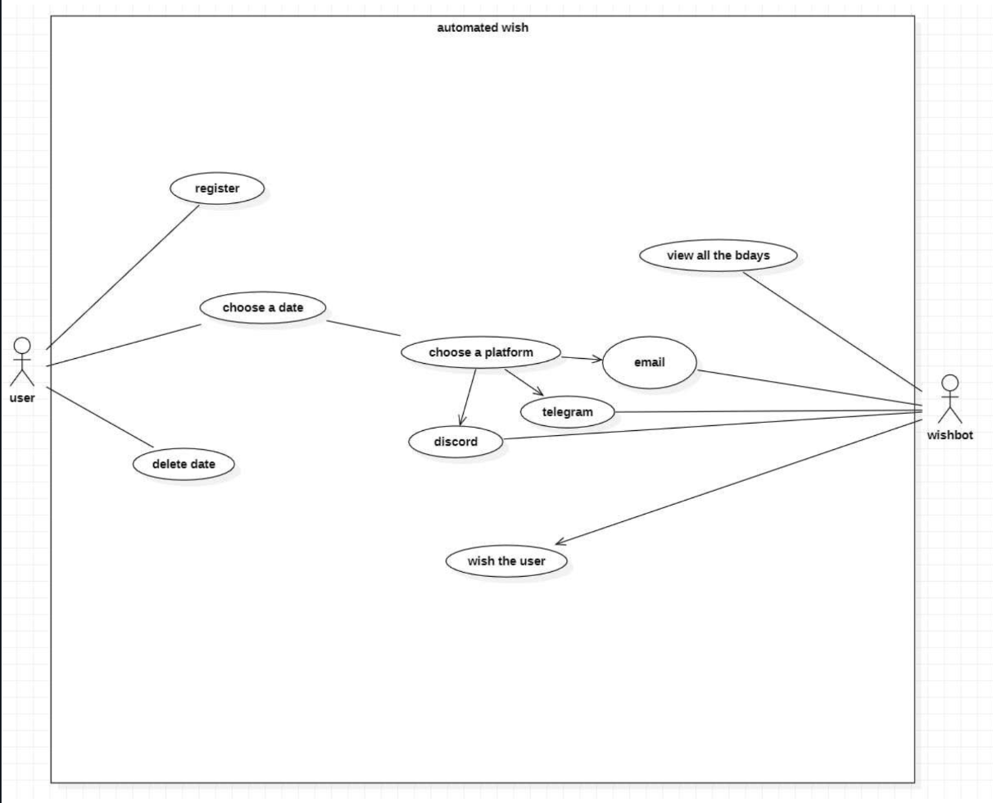
Use case diagram

Slide 9
Work division
Bot Designing : 2110030100, 2110030019
Frontend : 2110030110, 2110030100
Backend : 2110030041, 2110030019
Designing : 2110030019, 2110030110, 2110030041
Testing : 2110030041, 2110030100

Slide 10

THANKYOU ❤

